Slide 1
Flattening of plates
Tecnologia de Estaleiros Navais
2012

Slide 2
Preparation of surface

Slide 3
Flattening - Storage
Plate’s Roller

Slide 4
Plate’s Roller
Alternate bending

Slide 5
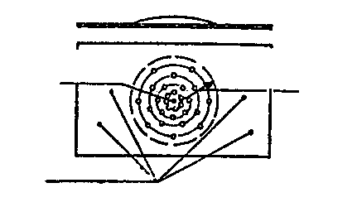
Flattening – hammer & press
Creation of deformation
Circular action decreasing from the centre
No action near the edges

Slide 6
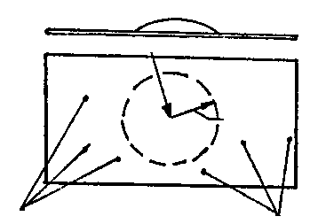
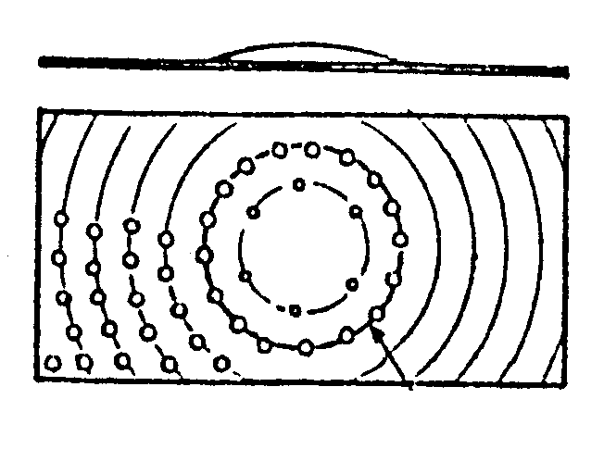
Removal a deformation with hammer
Circular action
Avoid to hit the contour of the plate
Not applicable when having multiple deformations

Slide 7
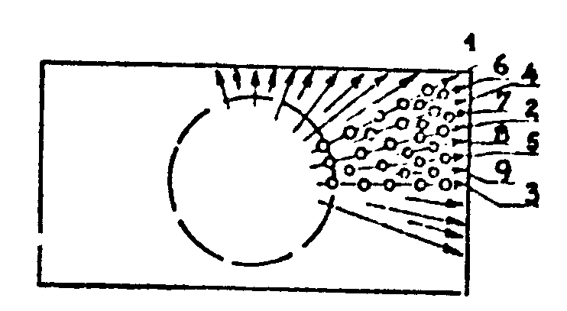
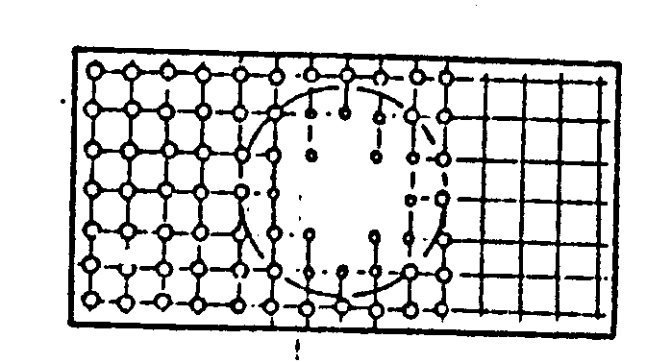
Removing a deformation with hammer
Radial action
Parallel action

Slide 8
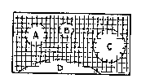
Removing a deformation with hammer
Multiple defects
Stretching
Hammer concave surface

Slide 9
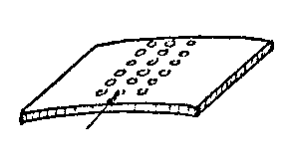
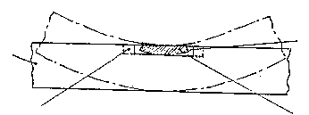
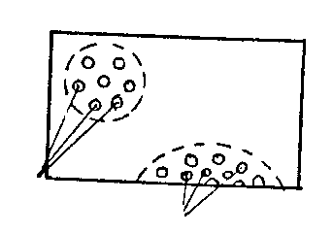
Plate’s flattening by heat
Half thickness heating
Points of heating

Slide 10
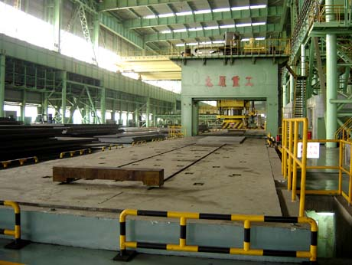
Mechanical flattening
Press
http://www.tyhi.com.cn/press/40mnypj.html

Slide 11
Tolerances
Localização | Location | Tolerance (mm)
Convés e duplo-fundo | Deck and double-bottom | 8
Pavimentos Cobertos Expostos | Superstructure Covered Not covered | 12 8
Cobertas | Intermediate decks | 10
Superestrutura Anteparas externas Anteparas internas Revestidas Não revestidas | Superstructure External Internal Covered Not covered | 10 12 8
Anteparas estruturais | Bulkheads | 10
Longarinas e sicórdias | Structural Girders | 8

Slide 12
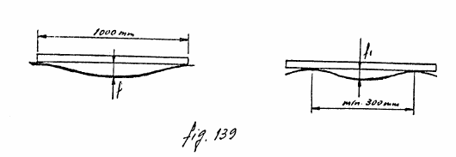
Measurements at inspection

Slide 13
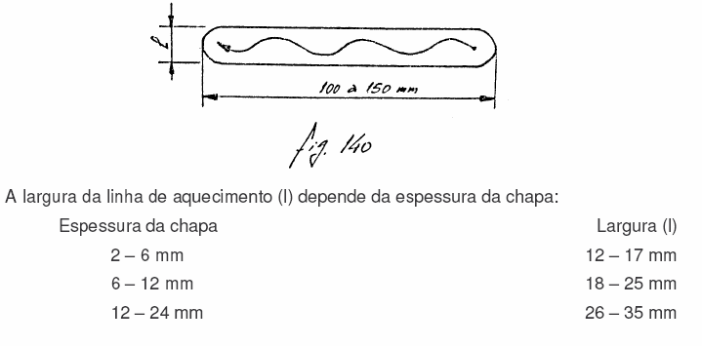
Flattening by line heating

Slide 15
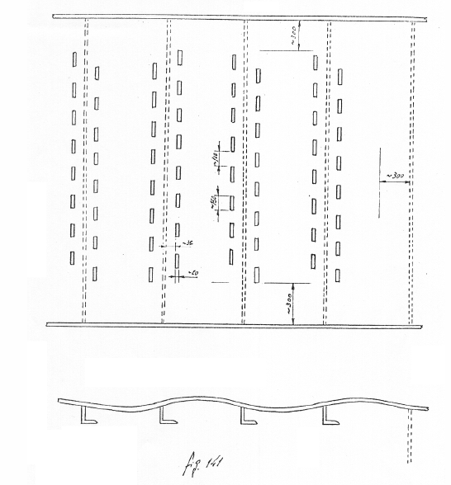
Flattening of panels

Slide 16
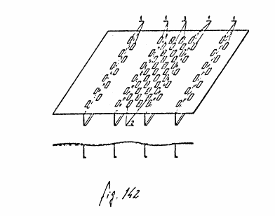
Flattening of panels

Slide 17
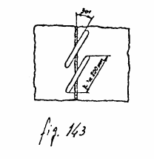
Correction to welding distortions
Oblique heating
Angle: 30º
Length: 200 mm
Width is function of the thickness

Slide 18
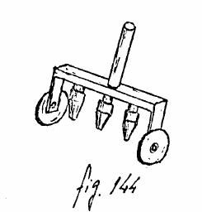
Multi-flame method

Slide 20
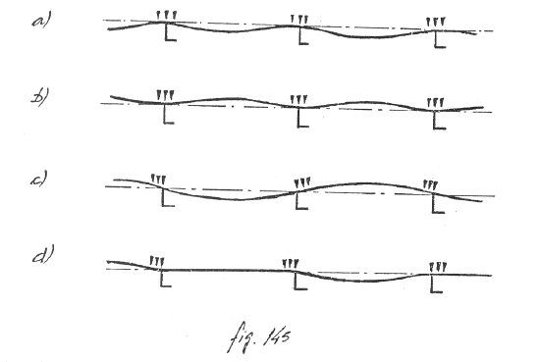
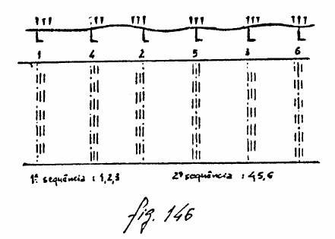
1st phase

Slide 21
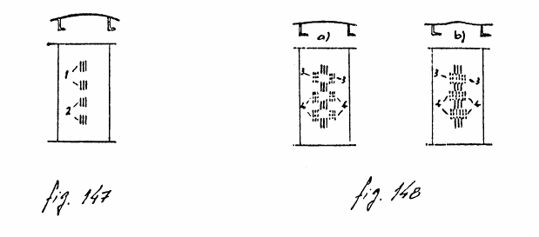
Second phase

Slide 22
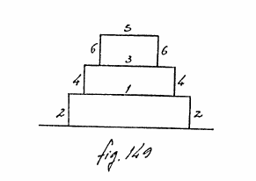
Corrections to superstructures

