Slide 1
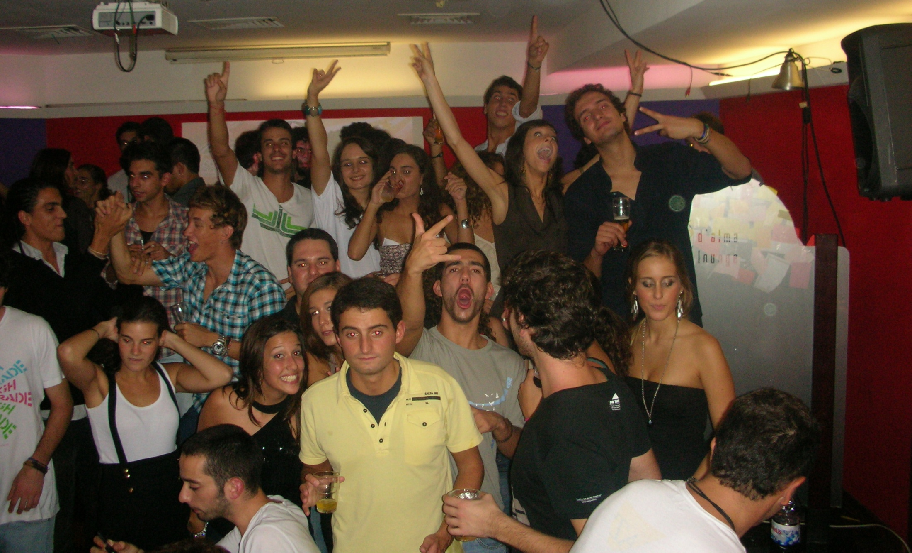
DOVE for real people

Slide 2
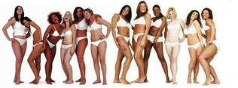
SWOT Analysis
Opportunities | Threaths
Increasing men concern with personal image General increase of the concerns with personal hygienic, care of body and face Growing of the market (0,7% in 2007 to 2008) About ¾ of Portuguese use beauty care products Innovation New trends in the Environmental concerns | Environmental concerns Economic crisis Competitive market Competitors don´t use palm oil in their product

Slide 3
SWOT Analysis
Strenghts | Weakness
Dove is one of the main Shower Gel brand Strong communication strategies “Real Beauty” Powerful advertising Great communication and distribution Differentiation Brand that loved by consumers | Some weak segments: - Men - Hair - Young In advertisement and products Has one of the higher price in Shower gel (comparing with competition) Environmental issues (about the palm oil) Easy to substitute

Slide 4
1. What can DOVE do to recover from the damage it suffered with Greenpeace attack
Notes:
http://www.youtube.com/watch?v=UU0SP91D9Js

Slide 5
New Environmental Friends Concept to DOVE
“Green Beauty for Real People”
Take off from the market the products with palm oil
A percentage of sales revenues reverting to combat deforestation
Make a advertising campaign showing the DOVE concerns with environment
In all products refer this concerns
Minimizing Packaging
Efficient transport (reducing CO2 emission)

Slide 6
2- If you decid to go to a repositioning strategy, how would you develop the communication to reach this new concept?

Slide 7
“Real Beauty, Real Concerns”
“Green Beauty for Real People”
Outdoors and TV advertising
Images from nature, first showing a forest with no trees, and gradually the image starts to have more trees.
The idea is to show in one side “We don´t want a world like this” and in the other side “So we do this”
Put everything in YouTube, lets share to everyone
Facebook: Create a DOVE application for Farmville where people can plant trees and take care of the, and with that

Slide 8
3- Ingridients changes, repositioning and communication

Slide 9
If we change the ingredients of DOVE products, the brand will stop being associated with killing the environment and attract ecological costumers
The new approach will be bio-organic products considering the new trends in consumer behavior. Nowadays people care more about natural solutions for the skin care.
Make a reformulation on packaging, transportation and make donations (as said before)

Slide 10
4 – How does DOVE´s position differ from its main competitors

Slide 11
SANNEX
Well hydrated and healthy skin, it´s more functional - offers solutions
JONHSON
Caring and soft solutions for sensitive skins, create emotional bonds
PALMOLIVE
Provide natural experiences
NIVEA
Supplies the tools to everyday women to feel their best
DOVE
Hydratation and simplicity

Slide 12
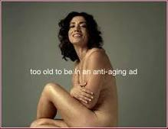
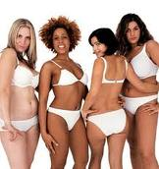
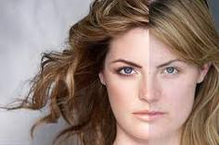
Main differences:
Communication
Positioning
Real Beauty
Shows the true beauty and is the only brand appealing to real women

Slide 13
5 – How can DOVE take advantage of the current social-cultural trends?

Slide 14
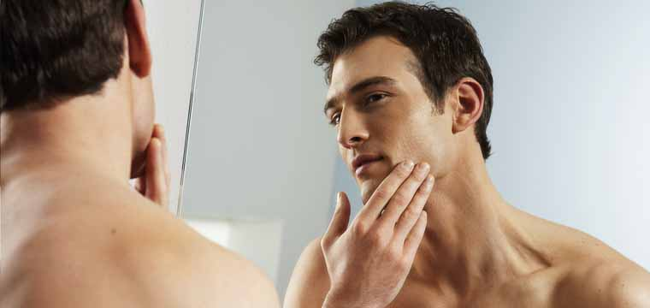
Development of the Men segment
Advertising for men 69% of men choose their own products so they deserve to have ads made for them, to influence them and make opt for DOVE
Develop face cream products

Slide 15
Case Evaluation
13 values
Strenghts | Weakness
Easy reading Relevant information Helps us to know the brand Good problem development | First title doesn´t correspond to the information Vasenol competitor Where is the men products? Repetitive Questions

