Slide 1


Ditte Rares - Filipa Geraldes –– Inês Fonseca – Marisa de Oliveira –Madalena Castelo Branco – Nadège da Silva
Master in Marketing Management
November 2010

Slide 2
Part 1 – 8 Values

Slide 3
Develop a situational analysis, taking into account its main features
Market
Competition
Consumer

Slide 4
Market
Expansion in the dairy products market:
Sales of dairy products increase
1550
1500
1450
1400
1350
1300
1250
0
Source: AC Nilsen Yearbook 2007 to 2009

Slide 5
Market
Market of yogurts represents about
€ 367 million of euros in 2009
370
365
360
355
350
345
340
335
330
0
Source: AC Nilsen Yearbook 2007 to 2009

Slide 6
Market
Increasing weight distribution of the brands

Slide 7
Market
Yogurt market dominated by Danone, Nestlé and Lactogal
Held 55% of the total value of sales of yogurts in Portugal
Source: http://www.hipersuper.pt/ 2008

Slide 8
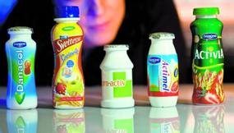
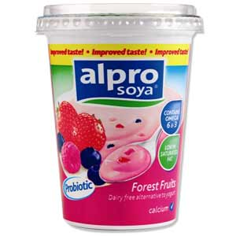
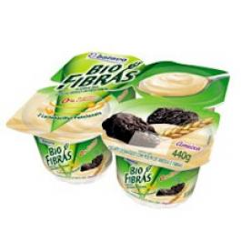
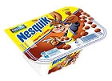
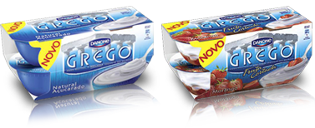
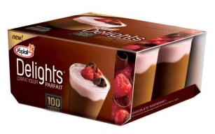
Market
New trends in yogurt market
Source: AC Nilsen Yearbook 2007 to 2009
Notes:
Soja, Probiotics, Fiber, Greek, Indulgence, Kids

Slide 9
Market
The yogurt market is categorized in:
Source: AC Nilsen Yearbook 2007 to 2009

Slide 10
Competition
The competition is quite large and it’s harder for competitors to find a competitive advantage that brings any differenciation. Among competitors is hard to find innovation and the highest market share belongs to Danone brand
Source: AC Nilsen Yearbook 2007 to 2009

Slide 11
Competition
Danone
Perceived as quality and trustful brand, 33% of market share
Distribution brands
Perceived with less quality but with 31% of market share
Lagtogal and other brands
Have both separately 10% of market share
Nestlé
with 16% of market share
Notes:
Nota das marcas de distribuição: distribution brands tend to be less “punished” by consumer, if doing something wrong, than known brands.
Nota da Lactogal: But Mimosa (a brand inside Lagtogal) is perceived as a quality and trustful brand.

Slide 12
Consumer Behavior
Source: AC Nilsen Yearbook 2007 to 2009

Slide 13
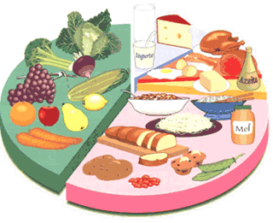
Consumer Behavior
Growing importance of yoghurt in the diet of consumers

Slide 14
Consumer Behavior
Growing consumers of organic yogurts
Increasing concern with line and health problems
Consumer concerns can lead to new yogurt types

Slide 15
Consumer Behavior
More than one segment: the eater, the drinkers, the healthiers…
Consumers turned to it as an affordable treat during the recession (Ex: yogurts), so the consumption recently grown

Slide 16
Consumer Behavior
Bet more in lunch and breakfast consumption
Source: TNS Worldpanel 2008

Slide 17

2. Prepare a Dynamic SWOT Analysis for Longa Vida
 | Strengths | Weakness
Opportunities
Theaths

Slide 18
Continuação da SWOT
Strengths
- Diversity of products
- Quality
- Strong targeting appropriate to various types of consumers and their needs
- Actual and potential competitiveness of the brand
- Innovative brand based on the consumers necessity
Joint-venture with world leading brand
Weakness
- Prices medium/high
- Difficult to differentiate products that can be easily replaced by other brands
- Negative growth rate
- Don´t have a light, organic and/or pro-biotic line
- Weak media divulgation

Slide 19
Opportunities
New insights into lifestyles and concerns about food
It is directed at the entire age structure
It's a brand with tradition and cultural value in the country
Market expansion in the dairy
New communication trends
Threaths
- Increase of competition with distribution brands
- Supremacy of Danone, leader of the market
- Economic crises in Portugal
- Market saturation

Slide 20
STRENGHTS
WEAKNESSES
OPPORTUNITIES
Communicate traditional values to Portuguese families, appealing to feelings. Longa Vida (taking advantage of strong targeting appropriation) create “prevent- osteoporoses yogurts” for aged consumers. And develop, for heatlh division, a yorgurt for active peole (energizer) | Develop new refrigerated yogurt targeted for consumer of organic yogurts. Use insights into lifestyles to differentiate products.
Invest on I&D (always been innovative brand) to gain competitive advantage in a very competitive market. Use the economic crises as an opportunity to sell more yogurts as affordable treats. | Cut on costs, to achieve lower prices. Advertise using new trends to gain notoriety: Facebook, blogs, youtube…
THREATS

Slide 21
3. Define the brand positioning

Slide 22
Longa Vida benefits from the good reputation that yoghurt has managed to establish in the past decades.
It has been able to eliminate food-scares of the past years more successfully than many other dairy-based foods with their healthy positioning and multipacks.
All of this is making them a convenient option for adults’ and children’s snacks and packed lunches. So Longa Vida is a brand that provides healthy foods consequently favoring the welfare, and hence the benefit of a balanced diet for the whole family.

Slide 23
Additionally, Longa Vida has the advantage of being a trusted and well-known brand in the yoghurt industry with emotional values attached to it, because of a long and respected history. Therefore, Longa Vida is often associated only with the classic yogurt glasses, which were the first yogurts sold by the brand.

Slide 24
4. Build a perceptual map for Longa Vida using the price and quality characteristics comparing with the following brands:
Danone
Mimosa
Distribution brands

Slide 25



Quality
Price
Distribution brands
Notes:
Longa vida is the brand with the higher price, but has not the higher quality
Danone has the higher quality and is the second higher price brand.

Slide 26
Parte 2 – 2 Values

Slide 27
1. Discuss the relevance of the distribution brands and the impact of them in the market

Slide 28
In a market with not much differentiation consumers prefer to spend less;
Economic downturn we are experiencing today is reflected in consumers' purchasing choices for cheaper products;
Increased consumption of distribution brands - came to be seen as a good alternative to major brands in the market - they do the same at lower prices;
The increasing importance of distribution brands has made the big market players would have to reduce prices to remain competitive;
Direct competitors need to launch products that add value and meet more specific needs in today’s market.

Slide 29
2. Comment the price strategy of Longa Vida, considering their direct competitors

Slide 30
Longa Vida prices are higher than its main competitors, but the brand strategy does not justify the higher price;
Because company strategy does not differentiate the product from the competitors, the higher prices are not acceptable in the consumer’s mind;
Higher prices could explain low market share when comparing to competitors (in recession consumers look for lower prices);
Main competitors: Danone and Mimosa, have a stronger communication strategy and more notoriety in the consumer’s mind which gives the brands more profits and the ability to practice lower price strategies.

Slide 31
Part 3 – 10 Values

Slide 32

1. Which is the variable of the marketing-mix that you think is more important for the success of the Longa Vida brand?

Slide 33
The communication of the brand;
As it is said in the case study, in yogurt market it is very hard to differentiate a brand from the competitors and gain competitive advantage (a brand can do something really innovative but after a while all the other brands will imitate it), but there is one important factor that can differentiate Longa Vida brand from its main competitors, that is: notoriety.
Notority can be achieved with great communication efforts;
In fact, consumers in this market have so many products that will satisfy their needs, that is almost indifferent to choose a brand over another. So, the purchasing decision will be determined by “which brand communicates better with them”.

Slide 34
2. Proposal of a Great distribution brand to produce yogurts under the Longa Vida brand name. Which are the advantages and disadvantages of accepting the proposal?

Slide 35
Advantages:
Higher profits in a short period of time;
Consumption of distribution brand increasing;
Greater negotiation power;
Distribution costs reduced in other products

Slide 36
Desvantagens:
Consumer will associate the quality of distribution brand yogurts to the Longa Vida brand yogurts;
Mobilization of some resources;
Consumption of distribution yogurts instead of Longa Vida, due to differences in price;
Possible damage of brand image.

Slide 37

3. What actions to implement at level of communication and placement?

Slide 38
Above the line
Notes:
Purchase of publicity spaces in websites with best visibility;
Use facebook to make known the Longa Vida Brand and its products and also create a page on facebook called “fans of Longa Vida”, or “Who have eat Longa Vida in Kid” or “People who love Longa Vida”;
Use TV commercials appealing to the familiarity of the brand;
Use of the brand in TV shows and soup operas.
Publicity on woman magazines for the healh yogurts, allying the brand to the health concept.

Slide 39
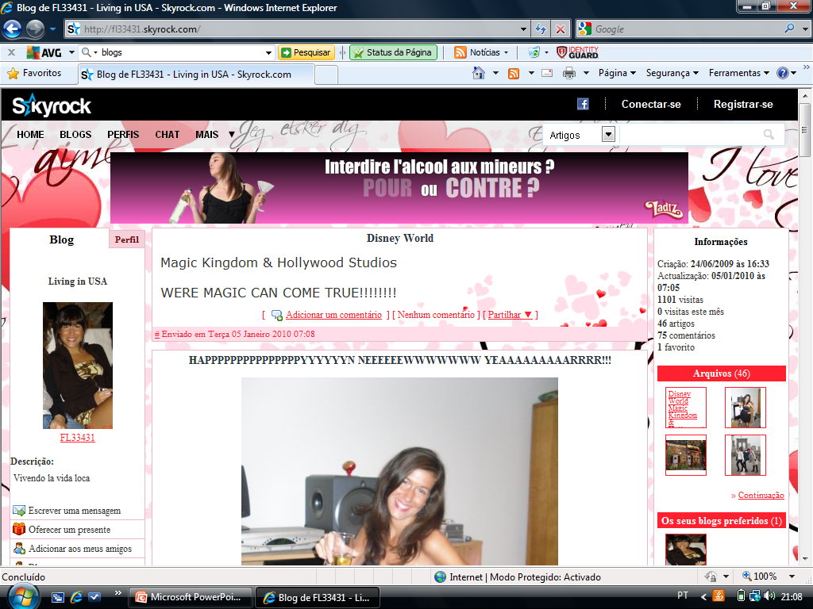

Slide 40
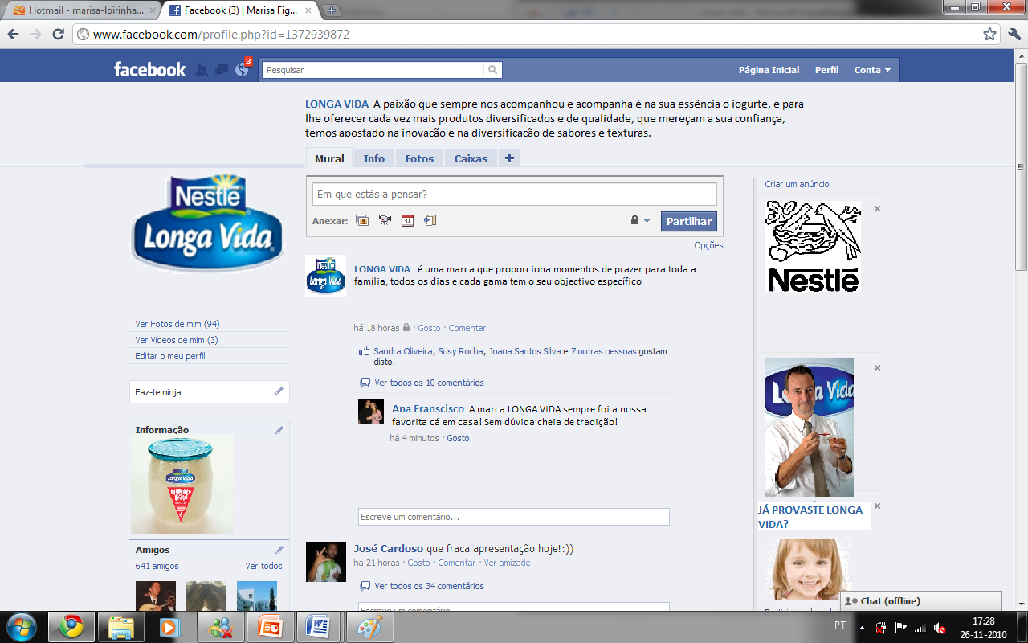
Notes:
Use facebook to make known the Longa Vida Brand and its products and also create a page on facebook called “fans of Longa Vida”, or “Who have eat Longa Vida in Kid” or “People who love Longa Vida”;

Slide 41


Notes:
Use TV commercials appealing to the familiarity of the brand;

Slide 42
http://www.youtube.com/watch?v=SgkiaVX1YCs&feature=related
Notes:
Exemplo da sumol a ser promovida nos morangos com açucar

Slide 43
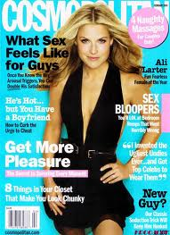


Slide 44
Below the line and in distribution channels

Slide 45
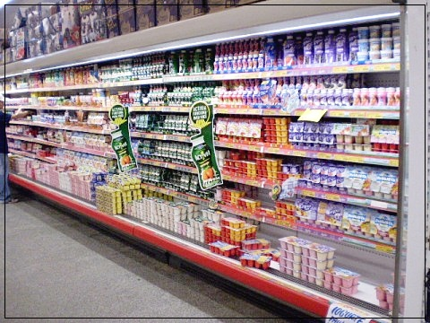
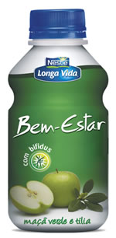
Notes:
Increased shelf space at the point of sale;
A new packing in order to make yogurt more appealing to
acquisition, as well as its visualization on the linear;

Slide 46
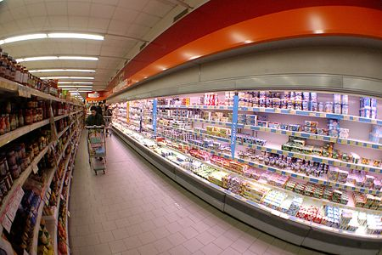
Events from the point of sale to encourage the purchase.
Notes:
The advantages of this action are several such as increasing sales, attracting new customers, get the advantage market over its competitors, increase customer loyalty and customer satisfaction.

Slide 47
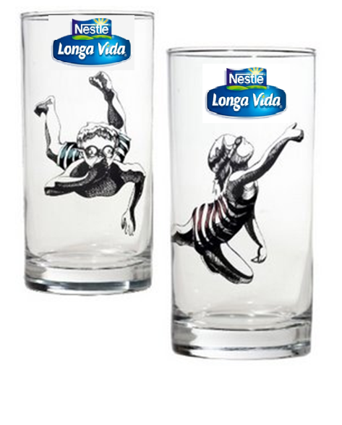


Notes:
For the promotion you must have a promoter. He or she will persuade the customer to choose our products through benefits and advantages of them. Offering a gift – glasees - on these
actions is a very important element because it can influence positively customer choice

