Slide 1
OBJECTIVOS ESTRATÉGICOS
Informar e divulgar a doença aos diversos stakeholders, de forma a mudar a atitude e o comportamento perante a doença
Angariar fundos para apoiar projectos com grande impacto na luta contra o cancro da mama em Portugal
Acompanhar de perto os projectos apoiados de forma a poder avaliar os resultados.
FONTE www.laco.pt
5

Slide 2
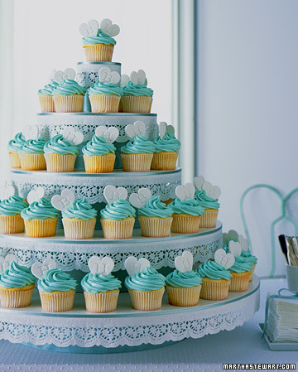
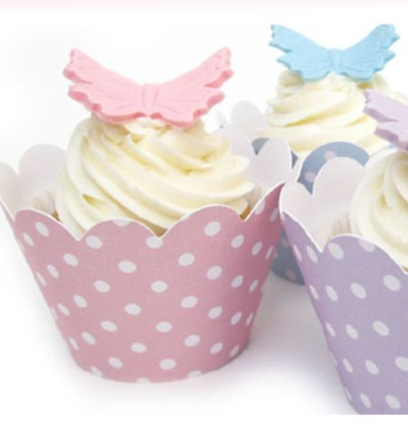
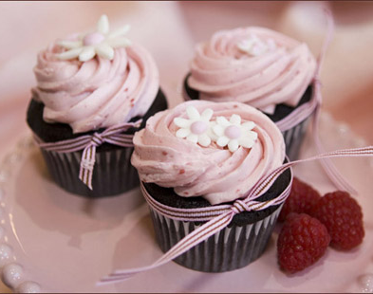
Master in Marketing
Strategic Marketing
Cátia Machado
Daniela Silva
Joana Ramalho
Rita Andrade
Roger Cao Vera Moreira
Professor: Hélia Pereira
November 2010

Slide 3
OBJECTIVOS ESTRATÉGICOS
Informar e divulgar a doença aos diversos stakeholders, de forma a mudar a atitude e o comportamento perante a doença
Angariar fundos para apoiar projectos com grande impacto na luta contra o cancro da mama em Portugal
Acompanhar de perto os projectos apoiados de forma a poder avaliar os resultados.
QUESTION 1
Cupcakes are a new market niche with a huge success in Portugal. Analyze their business attractiveness.
(2 Values)
FONTE www.laco.pt
5

Slide 4
QUESTION 1 – BUSINESS ATTRACTIVENESS
AGENDA
LAÇO
Missão e Visão
Objectivos Estratégicos
Estrutura Organizacional
Valores e Cultura
Liderança
Poder
DIAGNÓSTICO – PRÁTICAS DE RH
Planeamento
Recrutamento e Selecção
Acolhimento e Integração
Formação
Avaliação de Desempenho
Remunerações e Sistemas de Incentivo
Gestão de carreiras
Comunicação
PLANO DE RECOMENDAÇÕES
Cronograma
In each force, we gave four or more possible factors. People can make other correct factors.
Power of Buyers | Consumers are those who decide to buy the product Consumers can easily express their feelings and spread them to friends, family and also to strangers, by using blogs and social networks They have all the important information about the company Low brand loyalty Consumers don’t like to have limited choices
Rivalry within cupcake’s industry | There are only three relevant competitors: Tease, Cupcake*Bazaar and Pingo Doce The communication strategy of the market is majority below the line Products are very similar, the concept is, mainly, the difference between competitors Barriers to exit are low
High
High

Slide 5
QUESTION 1 – BUSINESS ATTRACTIVENESS
AGENDA
Threat of new entrants | Barriers to entry are low Products are easy to copy It´s not necessary a huge finance investment Cupcake’s market is new and small. There are lots of space to new entrants
Threat of substitutes | Substitute Products: All pastry cakes Just satisfied the rational side of consumers, not the emotional These products have small prices In general, they are industrialized products, with a lower quality Big distribution channels like Pingo Doce, Continente, Jumbo or Intermarché
LAÇO
Missão e Visão
Objectivos Estratégicos
Estrutura Organizacional
Valores e Cultura
Liderança
Poder
DIAGNÓSTICO – PRÁTICAS DE RH
Planeamento
Recrutamento e Selecção
Acolhimento e Integração
Formação
Avaliação de Desempenho
Remunerações e Sistemas de Incentivo
Gestão de carreiras
Comunicação
PLANO DE RECOMENDAÇÕES
Cronograma
High
Low
We just focuses in these four forces because we don’t have the necessary information in the case study about the power of suppliers.
Conclusion: The bussiness is attractive!

Slide 6
OBJECTIVOS ESTRATÉGICOS
Informar e divulgar a doença aos diversos stakeholders, de forma a mudar a atitude e o comportamento perante a doença
Angariar fundos para apoiar projectos com grande impacto na luta contra o cancro da mama em Portugal
Acompanhar de perto os projectos apoiados de forma a poder avaliar os resultados.
QUESTION 2
Make a S.W.O.T. analysis.
(2 Values)
FONTE www.laco.pt
5

Slide 7
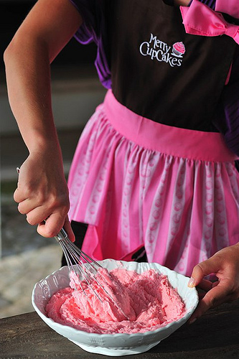
QUESTION 2 – SWOT ANALYSIS
AGENDA
LAÇO
Missão e Visão
Objectivos Estratégicos
Estrutura Organizacional
Valores e Cultura
Liderança
Poder
DIAGNÓSTICO – PRÁTICAS DE RH
Planeamento
Recrutamento e Selecção
Acolhimento e Integração
Formação
Avaliação de Desempenho
Remunerações e Sistemas de Incentivo
Gestão de carreiras
Comunicação
PLANO DE RECOMENDAÇÕES
Cronograma
In each point of SWOT Analysis, we gave four or more possible factors. People can make other correct factors.
OPPORTUNITIES | THREATS
Potentiality of cupcake’s market Cupcakes are fashionable Potential customers from the center south and islands Tendency of Portuguese people to copy behaviors that they see on TV | Tease cupcakes are more tasty and mini cupcakes are cheaper 10,9% of unemployment in Portugal and the increase of IVA to 23% Cupcakes are a fad Pingo Doce supermarket offer cupcakes at low prices This market don’t have too much barriers to entry Tendency of Portuguese people for having a healthier lifestyle and with low fat products
“A balanced diet is a cupcake in each hand.”

Slide 8
QUESTION 2 – SWOT ANALYSIS
AGENDA
LAÇO
Missão e Visão
Objectivos Estratégicos
Estrutura Organizacional
Valores e Cultura
Liderança
Poder
DIAGNÓSTICO – PRÁTICAS DE RH
Planeamento
Recrutamento e Selecção
Acolhimento e Integração
Formação
Avaliação de Desempenho
Remunerações e Sistemas de Incentivo
Gestão de carreiras
Comunicação
PLANO DE RECOMENDAÇÕES
Cronograma
STRENGTHS | WEAKNESSES
Pioneer in cupcake’s market Their strategic alliances with well known brands such Hello Kitty, Dior, Santini, etc Very girly and sweet image Cupcakes have an attractive and tasty look Placed in the main shopping centers of Lisbon Thematic cupcakes Accept orders for big and important parties like weddings and birthdays High quality products | Flavors don’t correspond to the cupcake’s image Cupcakes are extremely sweet and caloric Only have sale stands Don’t have a place where consumers can relax and appreciate their cupcake Often, they sell all the stock before the store close

Slide 9
OBJECTIVOS ESTRATÉGICOS
Informar e divulgar a doença aos diversos stakeholders, de forma a mudar a atitude e o comportamento perante a doença
Angariar fundos para apoiar projectos com grande impacto na luta contra o cancro da mama em Portugal
Acompanhar de perto os projectos apoiados de forma a poder avaliar os resultados.
QUESTION 3
Define critical success factors of Merry Cupcakes.
(1,5 Value)
FONTE www.laco.pt
5
Notes:
ZE

Slide 10
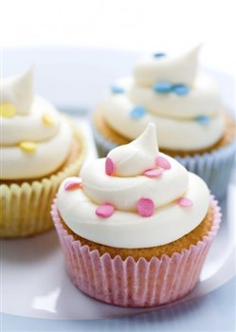
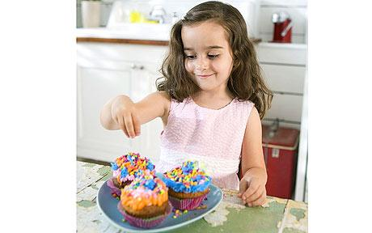
QUESTION 3 – CRITICAL SUCCESS FACTORS
AGENDA
LAÇO
Missão e Visão
Objectivos Estratégicos
Estrutura Organizacional
Valores e Cultura
Liderança
Poder
DIAGNÓSTICO – PRÁTICAS DE RH
Planeamento
Recrutamento e Selecção
Acolhimento e Integração
Formação
Avaliação de Desempenho
Remunerações e Sistemas de Incentivo
Gestão de carreiras
Comunicação
PLANO DE RECOMENDAÇÕES
Cronograma
The answer to this question may have these 5 factors but people can give some other examples, and not be limited to this five
Quality/Price Relationship;
Creativity;
Concept;
Unique Taste;
Cake Design.
“God gave the angels wings, and he gave humans cupcakes.”

Slide 11
OBJECTIVOS ESTRATÉGICOS
Informar e divulgar a doença aos diversos stakeholders, de forma a mudar a atitude e o comportamento perante a doença
Angariar fundos para apoiar projectos com grande impacto na luta contra o cancro da mama em Portugal
Acompanhar de perto os projectos apoiados de forma a poder avaliar os resultados.
QUESTION 4
Describe the current Segmentation, Targeting and Positioning chosen by Merry Cupcakes.
(2 Values)
FONTE www.laco.pt
5

Slide 12
QUESTION 4 – SEGMENTATION, TARGETING AND POSITIONING
AGENDA
LAÇO
Missão e Visão
Objectivos Estratégicos
Estrutura Organizacional
Valores e Cultura
Liderança
Poder
DIAGNÓSTICO – PRÁTICAS DE RH
Planeamento
Recrutamento e Selecção
Acolhimento e Integração
Formação
Avaliação de Desempenho
Remunerações e Sistemas de Incentivo
Gestão de carreiras
Comunicação
PLANO DE RECOMENDAÇÕES
Cronograma
Segmentation Criteria
Targeting Criteria
Demographic: age and gender;
Geographic: employment or housing places;
Social Economic: social class
Behavioral: personality, attitude
Age: [3-10]; [11-17]; [18-45]
Gender: Females
Geographic: Lisbon and Oporto City
Social Economic: Class A/B and C1
“Cupcakes are happiness condensed in one second.”

Slide 13
QUESTION 4 – SEGMENTATION, TARGETING AND POSITIONING
AGENDA
In targeting, we gave four or more possible factors. People can make other correct factors.
LAÇO
Missão e Visão
Objectivos Estratégicos
Estrutura Organizacional
Valores e Cultura
Liderança
Poder
DIAGNÓSTICO – PRÁTICAS DE RH
Planeamento
Recrutamento e Selecção
Acolhimento e Integração
Formação
Avaliação de Desempenho
Remunerações e Sistemas de Incentivo
Gestão de carreiras
Comunicação
PLANO DE RECOMENDAÇÕES
Cronograma
Targeting – Behavioral: In and/or out of home
Behavioral:
[3-10]
Extrovert;
Creative;
Impulsive;
Enjoy sweet candies.
[18-45]
Fashion followers;
Trend followers;
Like to experiment new products;
Modern;
Active;
Girly;
Urban;
Greedy;
Happy and with attitude.
[11-17]
Hit girls;
Modern;
Girly;
Pop girls.
“Cupcakes are happiness condensed in one second.”

Slide 14
QUESTION 4 – SEGMENTATION, TARGETING AND POSITIONING
AGENDA
LAÇO
Missão e Visão
Objectivos Estratégicos
Estrutura Organizacional
Valores e Cultura
Liderança
Poder
DIAGNÓSTICO – PRÁTICAS DE RH
Planeamento
Recrutamento e Selecção
Acolhimento e Integração
Formação
Avaliação de Desempenho
Remunerações e Sistemas de Incentivo
Gestão de carreiras
Comunicação
PLANO DE RECOMENDAÇÕES
Cronograma
Positioning
Identification: cakes with decorative coverage
Differentiation: artistic cupcakes, unique, with thematic and personalized decorations.
Consumers’ expectations:
Quality, appealing, flavor, diversity, tasty, a good experience
Competitors’ positioning:
Tease: offer an unique experience, beyond the cupcake; desire and curiosity arousal through a provocative image; to rebel people, who enjoy to dazzle with design and with what the brand provides
Bazaar: homemade cupcakes, tailored to each consumer and to share funny moments with other people
Merry Cupcakes’ trumps:
Pioneer, appealing image associated to several events, provide services in order to assist in important moments
“Cupcakes are happiness condensed in one second.”

Slide 15
OBJECTIVOS ESTRATÉGICOS
QUESTION 5
With the Segmentation and Targeting that you define in the previous question, choose the cluster that you think is more relevant for Merry Cupcakes. Justify your answer and make a communication strategy for that same cluster.
(3 values)
Informar e divulgar a doença aos diversos stakeholders, de forma a mudar a atitude e o comportamento perante a doença
Angariar fundos para apoiar projectos com grande impacto na luta contra o cancro da mama em Portugal
Acompanhar de perto os projectos apoiados de forma a poder avaliar os resultados.
FONTE www.laco.pt
5

Slide 16
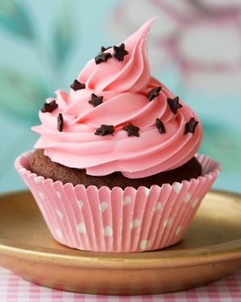
QUESTION 5 – CHOOSE A CLUSTER AND MAKE A COMMUNICATION STRATEGY
AGENDA
LAÇO
Missão e Visão
Objectivos Estratégicos
Estrutura Organizacional
Valores e Cultura
Liderança
Poder
DIAGNÓSTICO – PRÁTICAS DE RH
Planeamento
Recrutamento e Selecção
Acolhimento e Integração
Formação
Avaliação de Desempenho
Remunerações e Sistemas de Incentivo
Gestão de carreiras
Comunicação
PLANO DE RECOMENDAÇÕES
Cronograma
In terms of communication, we consider that the company should continue with their strategy of promotion (bellow the line), based in:
Word of Mouth; Viral Marketing; Sensorial Marketing; Events; Television Interviews.
We create four alternatives to answer this question. Students only need to chose one.
In each alternative, we gave three or four possible actions, but students can give more or less actions. However they can also suggest other actions since they are creative, innovative and using relevant media to get to the main target.

Slide 17
QUESTION 5 – CHOOSE A CLUSTER AND MAKE A COMMUNICATION STRATEGY
AGENDA
First Alternative
LAÇO
Missão e Visão
Objectivos Estratégicos
Estrutura Organizacional
Valores e Cultura
Liderança
Poder
DIAGNÓSTICO – PRÁTICAS DE RH
Planeamento
Recrutamento e Selecção
Acolhimento e Integração
Formação
Avaliação de Desempenho
Remunerações e Sistemas de Incentivo
Gestão de carreiras
Comunicação
PLANO DE RECOMENDAÇÕES
Cronograma
Target | 3-10 (Kids)
Message | Have fun with kids
Action | Create a mascot to attract children Partnership with Panda Channel Develop a birthday service
Children are an important target to Merry Cupcakes. Children are attracted by Cupcakes due to its color and fun decorations. Their persuasiveness is huge, which makes it easy to influence parents to buy them cupcakes. Objectives are: create an identification brand, something different and funny for playing. Using a streamline communication for the younger segment.

Slide 18
QUESTION 5 – CHOOSE A CLUSTER AND MAKE A COMMUNICATION STRATEGY
AGENDA
1. Create a mascot: for example, we think that the mascot could be a unicorn (because of fairy tales) called “Merry” (to keep the brand name, so that there is identification with the company). So we think that the unicorn may represent the brand and the concept because we want to transmit to children a nice, docile and imaginary brand.
LAÇO
Missão e Visão
Objectivos Estratégicos
Estrutura Organizacional
Valores e Cultura
Liderança
Poder
DIAGNÓSTICO – PRÁTICAS DE RH
Planeamento
Recrutamento e Selecção
Acolhimento e Integração
Formação
Avaliação de Desempenho
Remunerações e Sistemas de Incentivo
Gestão de carreiras
Comunicação
PLANO DE RECOMENDAÇÕES
Cronograma
2. Partnership with Panda Channel: Make a cupcake party with Merry Mascot and Panda. Tickets would be charged.
To develop the following activities:
Race of cupcakes: clothes that children dress in races and have to win to make cupcakes or other accessories (Merry unicorns, merchandising mentioned in the previous action.);
Each ticket has a coupon that is used to decorate a cupcake, so each child has the opportunity to decorate to their taste, however they can only do it once;
Inflatables;
Music – mini Panda concert
3. Develop a birthday service: Animate birthday parties. Having two face painters, playing games and cooking cupcakes with children.

Slide 19
QUESTION 5 – CHOOSE A CLUSTER AND MAKE A COMMUNICATION STRATEGY
AGENDA
Second Alternative
LAÇO
Missão e Visão
Objectivos Estratégicos
Estrutura Organizacional
Valores e Cultura
Liderança
Poder
DIAGNÓSTICO – PRÁTICAS DE RH
Planeamento
Recrutamento e Selecção
Acolhimento e Integração
Formação
Avaliação de Desempenho
Remunerações e Sistemas de Incentivo
Gestão de carreiras
Comunicação
PLANO DE RECOMENDAÇÕES
Cronograma
Target | 11-17 Teenagers
Message | Enjoy pink life
Action | Write a column in a magazine for teenagers Applications on Social Network Sell cupcakes cheaper between 11 and 12 p.m., in malls with cinema Offer a cupcake at consumer birthday
This segment is very important, because teenagers (specially girls) like to follow trends. Girls like fashionable things and love spend quality time with their friends.
Objectives are: promote Merry Cupcakes’ brand, creating a brand connection. Its also important boost the brand generating some buzz around it and turn the activity of eating cupcakes in a fun experience to have with friends

Slide 20
QUESTION 5 – CHOOSE A CLUSTER AND MAKE A COMMUNICATION STRATEGY
AGENDA
Press: since Merry Cupcakes have a stand in series “Morangos com Açúcar” is relevant to continue to promote the brand for this cluster. They could have a column in a magazine that is more relevant to this target as “100% Jovem” and “Bravo”. This column will have some statements about the cupcake concept, to give tips, with little revenue, on how to organize a party or a snack with friends. They could also update events, parties and lunches that Merry Cupcakes may do (MTV, Portugal Fashion).
LAÇO
Missão e Visão
Objectivos Estratégicos
Estrutura Organizacional
Valores e Cultura
Liderança
Poder
DIAGNÓSTICO – PRÁTICAS DE RH
Planeamento
Recrutamento e Selecção
Acolhimento e Integração
Formação
Avaliação de Desempenho
Remunerações e Sistemas de Incentivo
Gestão de carreiras
Comunicação
PLANO DE RECOMENDAÇÕES
Cronograma
2. Applications on Social Network: create applications with phrases and questions about their friends on Facebook. These phrases are related with themes like friendship, fun, love and adventure.
3. Sell cheaper cupcakes between 11 and 12 p.m., in malls with cinema: in malls where Merry Cupcakes exist and where exist cinema, cupcakes should be sold at lower prices, for example, with 20% of discount to all students, between 11 and 12 p.m.
4. Offer a cupcake at consumer birthday: on birthday, by showing an identity card, you receive a free cupcake.

Slide 21
QUESTION 5 – CHOOSE A CLUSTER AND MAKE A COMMUNICATION STRATEGY
AGENDA
Third Alternative
LAÇO
Missão e Visão
Objectivos Estratégicos
Estrutura Organizacional
Valores e Cultura
Liderança
Poder
DIAGNÓSTICO – PRÁTICAS DE RH
Planeamento
Recrutamento e Selecção
Acolhimento e Integração
Formação
Avaliação de Desempenho
Remunerações e Sistemas de Incentivo
Gestão de carreiras
Comunicação
PLANO DE RECOMENDAÇÕES
Cronograma
Target | 18-45 Grownups
Message | Unique moments to share with your friends
Action | Write a column in fashion magazines Hot air balloon photo contest Teaser Campaign
Basically grownups eat cupcakes to remember their childhood. Life is too complicated that some times people just want to enjoy a good/magical moment. Besides that, they have a high power of decision and purchase which is very important for Merry Cupcakes business .
Objectives are: increase reputation, create a brand connection to customers, create buzz and to promote the relationship with clients.

Slide 22
QUESTION 5 – CHOOSE A CLUSTER AND MAKE A COMMUNICATION STRATEGY
AGENDA
LAÇO
Missão e Visão
Objectivos Estratégicos
Estrutura Organizacional
Valores e Cultura
Liderança
Poder
DIAGNÓSTICO – PRÁTICAS DE RH
Planeamento
Recrutamento e Selecção
Acolhimento e Integração
Formação
Avaliação de Desempenho
Remunerações e Sistemas de Incentivo
Gestão de carreiras
Comunicação
PLANO DE RECOMENDAÇÕES
Cronograma
1. Press: have a column in magazines that are more relevant to this target such as: “Happy”, “Cosmopolitan”.
They can develop tips for parties and snacks with friends, activities, important phrases about women and cupcakes, disclosure of the concept through cupcake accessories (Clothing, boots, fashion accessories).
Hot Air Balloon Contest: a contest to celebrate the first anniversary of Merry Cupcakes, which consists on the following: during the entire month of February of the next year, all Portuguese population could compete, by sending a super original photo (for instance, a photo of people eating a Merry cupcake).
These same photos will be uploaded on Facebook and fans will vote on the photo they like the most.
Five most voted photos win a trip in a hot air balloon for four people. Winners will be announced at Merry Cupcakes birthday, March 15th, 2011.
4. Teaser Campaign: create a campaign of suspense, during two weeks, using some marketing guerrilla. Those are the actions that we propose.
Muppies in subway stations and buses;
Painted messages on the road with pink fluorescent ink;
Underlining some of the trees in Lisbon and Porto with pink card
Pink arrows in shopping centers to indicate the path to Merry Cupcakes stands;
After these two weeks, do a campaign to identify the product and brand.

Slide 23
QUESTION 5 – CHOOSE A CLUSTER AND MAKE A COMMUNICATION STRATEGY
AGENDA
Fourth Alternative
LAÇO
Missão e Visão
Objectivos Estratégicos
Estrutura Organizacional
Valores e Cultura
Liderança
Poder
DIAGNÓSTICO – PRÁTICAS DE RH
Planeamento
Recrutamento e Selecção
Acolhimento e Integração
Formação
Avaliação de Desempenho
Remunerações e Sistemas de Incentivo
Gestão de carreiras
Comunicação
PLANO DE RECOMENDAÇÕES
Cronograma
Target | Take Home
Message | For special moments
Action | Partnership with wedding planners. Start to organize birthday parties Flyers on Birthday party shops
We create this third alternative because this target are very important in terms of income to Merry Cupcakes. Majorly, people buy cupcakes in the stand to eat at home or make online orders to some parties.
Objectives are: boost the brand, gain more clients, simplify and facilitate the life of the person who organizes the party and associate the brand “Merry Cupcakes” with a sense of belonging, confidence and fun.

Slide 24
QUESTION 5 – CHOOSE A CLUSTER AND MAKE A COMMUNICATION STRATEGY
AGENDA
1. Partnership with wedding planners: Make a partnership with wedding planners, so when the fiancés contract this company, Merry Cupcakes can be a choice to have in their marriage, because they show their work to them.
They can offer cupcakes to guests, have these sweets in their lunch or snack, or maybe have a wedding cake with this format.
For example, with this partnership we can have the name of our company in the home page of the organizing wedding companies.
LAÇO
Missão e Visão
Objectivos Estratégicos
Estrutura Organizacional
Valores e Cultura
Liderança
Poder
DIAGNÓSTICO – PRÁTICAS DE RH
Planeamento
Recrutamento e Selecção
Acolhimento e Integração
Formação
Avaliação de Desempenho
Remunerações e Sistemas de Incentivo
Gestão de carreiras
Comunicação
PLANO DE RECOMENDAÇÕES
Cronograma
2. Start to organize birthday parties: After the initial contact from the parent or other type of consumer, we take care of everything that has to be done:
- Establishment of calls
- Rental of Space
- Providence of catering
- Children’ entertainers
3. Flyers on Birthday party shops: Objectives: Give information about our services: Organization of children parties and accept orders of cupcakes for parties.
Reach the target in a direct way
Description:
Make flyers with the important information, and with an attractive look
Request to shops that sell party items that allow us to put our flyers on the counter

Slide 25
OBJECTIVOS ESTRATÉGICOS
Informar e divulgar a doença aos diversos stakeholders, de forma a mudar a atitude e o comportamento perante a doença
Angariar fundos para apoiar projectos com grande impacto na luta contra o cancro da mama em Portugal
Acompanhar de perto os projectos apoiados de forma a poder avaliar os resultados.
QUESTION 6
Do you think that Merry Cupcakes has what it takes to be a tribal brand in the future? Justify your answer. (2,5 values)
FONTE www.laco.pt
5

Slide 26
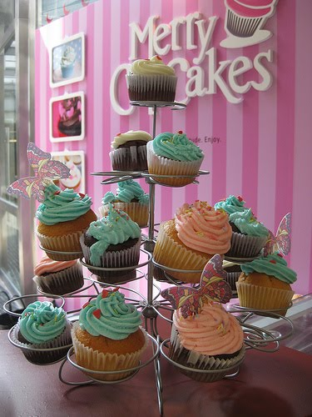
QUESTION 6 – TRIBAL BRAND_IN THE FUTURE
AGENDA
LAÇO
Missão e Visão
Objectivos Estratégicos
Estrutura Organizacional
Valores e Cultura
Liderança
Poder
DIAGNÓSTICO – PRÁTICAS DE RH
Planeamento
Recrutamento e Selecção
Acolhimento e Integração
Formação
Avaliação de Desempenho
Remunerações e Sistemas de Incentivo
Gestão de carreiras
Comunicação
PLANO DE RECOMENDAÇÕES
Cronograma
Tribal Marketing
We believe that this brand have all that it takes to became a tribal brand in the next years, but only a few factors will lead to this situation, like:
Way of marketing that focuses on creating groups with common interests and give them products that meet their needs and desires
Increase of fans in Facebook (less than a month they have more 5282 fans)
It’s not just a number, consumers use this home page to share experiences about making or eating cupcakes, to ask for advices to Merry Cupcakes, and more other things. And now they launched their recipe book, so people can make their own cupcakes and share this in Facebook.
“Don't wreck a sublime experience by feeling guilty.”

Slide 27
QUESTION 6 – TRIBAL BRAND_IN THE FUTURE
AGENDA
LAÇO
Missão e Visão
Objectivos Estratégicos
Estrutura Organizacional
Valores e Cultura
Liderança
Poder
DIAGNÓSTICO – PRÁTICAS DE RH
Planeamento
Recrutamento e Selecção
Acolhimento e Integração
Formação
Avaliação de Desempenho
Remunerações e Sistemas de Incentivo
Gestão de carreiras
Comunicação
PLANO DE RECOMENDAÇÕES
Cronograma
Cupcakes
Concept
Core business of Merry Cupcakes
Connect people and help them to feel special
This is a funny product, that has to be present in all happy moments of consumers. The cute and magical appearance of the cupcake gives us a feeling of joy, and it’s also because of it that lots of people call it fairy cake. This whole feeling of unity, sharing and joy makes consumers join in a group, a tribe.
The interaction between elements of the company with many fans of the brand, the photo sharing and experiences of consumers to indulge themselves with cupcakes, has the chance to promote this new concept of tribe.
“Don't wreck a sublime experience by feeling guilty.”

Slide 28
OBJECTIVOS ESTRATÉGICOS
Informar e divulgar a doença aos diversos stakeholders, de forma a mudar a atitude e o comportamento perante a doença
Angariar fundos para apoiar projectos com grande impacto na luta contra o cancro da mama em Portugal
Acompanhar de perto os projectos apoiados de forma a poder avaliar os resultados.
QUESTION 7
What kind of strategy did Merry Cupcakes use? In your answer use the model that you think it fit´s better. (2 Values)
FONTE www.laco.pt
5

Slide 29
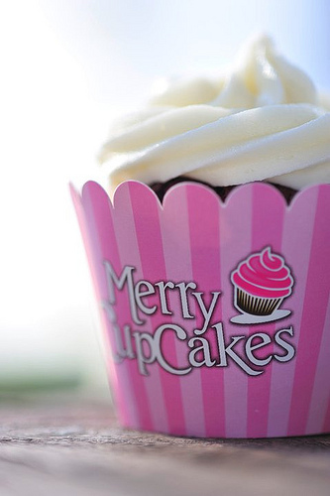
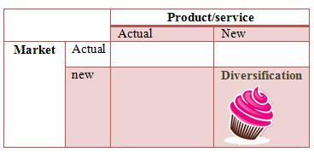
QUESTION 7 – MARKETING STRATEGY
AGENDA
We are going to analyze Merry Cupcakes’ strategy, using Ansoff matrix.
LAÇO
Missão e Visão
Objectivos Estratégicos
Estrutura Organizacional
Valores e Cultura
Liderança
Poder
DIAGNÓSTICO – PRÁTICAS DE RH
Planeamento
Recrutamento e Selecção
Acolhimento e Integração
Formação
Avaliação de Desempenho
Remunerações e Sistemas de Incentivo
Gestão de carreiras
Comunicação
PLANO DE RECOMENDAÇÕES
Cronograma
New niche market:
The concept of offering an experience of happiness and sharing it with people they like, occupies a completely different segment from what already exists.
Pioneer in selling cupcakes, in Portugal, because the concept of femininity, cuteness and fairytales awoke in the consumer a need that was not previously explored.
New Product:
More than one “product added”, the cupcake wants to offer a special moment of happiness to those who eat it.
It’s not so much the physical product that is new, but the whole concept that surrounds it.

Slide 30
OBJECTIVOS ESTRATÉGICOS
Informar e divulgar a doença aos diversos stakeholders, de forma a mudar a atitude e o comportamento perante a doença
Angariar fundos para apoiar projectos com grande impacto na luta contra o cancro da mama em Portugal
Acompanhar de perto os projectos apoiados de forma a poder avaliar os resultados.
QUESTION 8
As is stated in the case, cupcakes emerged in America as a way to meet the needs of its inhabitants. Knowing that American culture is different of European culture in terms of consumption and eating habits, did Merry Cupcakes come with the right concept and the right product to the Portuguese market? What should have been done from the beginning to improve its market perception and position? And what can be done now for the Merry Cupcakes’ triumph in this market in the next years? (2,5 Values)
FONTE www.laco.pt
5

Slide 31
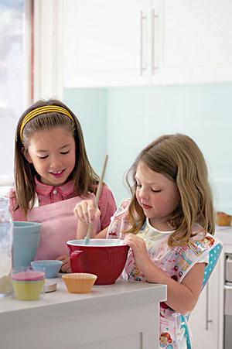
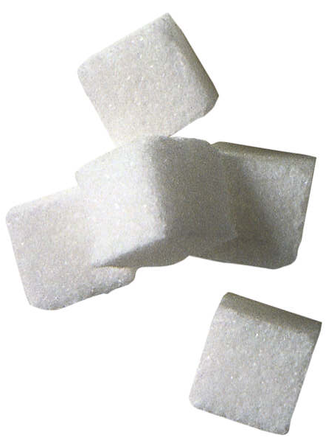
AGENDA
QUESTION 8 – CONSUMER BEHAVIOR
LAÇO
Missão e Visão
Objectivos Estratégicos
Estrutura Organizacional
Valores e Cultura
Liderança
Poder
DIAGNÓSTICO – PRÁTICAS DE RH
Planeamento
Recrutamento e Selecção
Acolhimento e Integração
Formação
Avaliação de Desempenho
Remunerações e Sistemas de Incentivo
Gestão de carreiras
Comunicação
PLANO DE RECOMENDAÇÕES
Cronograma
America:
Portugal:
The recipe of cupcakes that they use is too sweet and caloric to our regular diet
The recipe is based in the American and English cupcake without any adaptation
Flavors that they choose are inconsistent with the Portuguese favorite ones
American people love sugar and consume the double in comparison with Portugal
“Life is uncertain. Eet dessert first.”

Slide 32
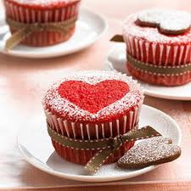
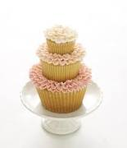
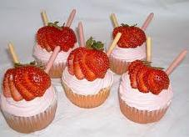
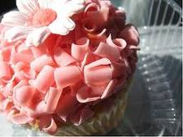
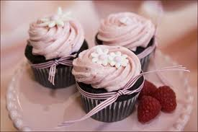
QUESTION 8 – CONSUMER BEHAVIOR
AGENDA
LAÇO
Missão e Visão
Objectivos Estratégicos
Estrutura Organizacional
Valores e Cultura
Liderança
Poder
DIAGNÓSTICO – PRÁTICAS DE RH
Planeamento
Recrutamento e Selecção
Acolhimento e Integração
Formação
Avaliação de Desempenho
Remunerações e Sistemas de Incentivo
Gestão de carreiras
Comunicação
PLANO DE RECOMENDAÇÕES
Cronograma
Keep the concept behind the cupcake equal to either light or normal products.
Maintain the feeling of a special moment, of a dream and also of a delicious singular cupcake.
Maintain the original recipe and continue to innovate in flavors, such as, fruit with a less sugar, for Portuguese flavors (not all consumers are concerned about the amount of sugar they ingest when enjoying a cupcake)
“Life is uncertain. Eet dessert first.”

Slide 33
OBJECTIVOS ESTRATÉGICOS
Informar e divulgar a doença aos diversos stakeholders, de forma a mudar a atitude e o comportamento perante a doença
Angariar fundos para apoiar projectos com grande impacto na luta contra o cancro da mama em Portugal
Acompanhar de perto os projectos apoiados de forma a poder avaliar os resultados.
QUESTION 9
Being Merry Cupcakes a company with an easy copyable product, what should they do, to keep their market position in a way to defend themselves to the growing entrance of new competitors? (2,5 Values)
FONTE www.laco.pt
5
Notes:
ZE

Slide 34
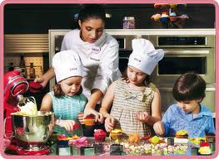
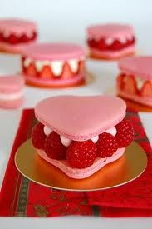
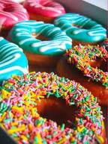
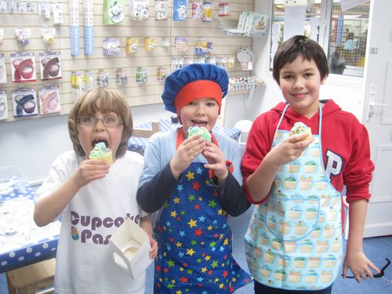
QUESTION 9 – MARKETING STRATEGY_COMPETITIVE ADVANTAGES
AGENDA
We create two alternatives to answer this question. Students only need to choose one.
In each of these alternatives, we gave some possible examples. People can make other examples since they are creative and relevant. Examples that we gave are merely illustrative of a possible product that can be expanded. They may differ from person to person, provided that the response is well-founded.
LAÇO
Missão e Visão
Objectivos Estratégicos
Estrutura Organizacional
Valores e Cultura
Liderança
Poder
DIAGNÓSTICO – PRÁTICAS DE RH
Planeamento
Recrutamento e Selecção
Acolhimento e Integração
Formação
Avaliação de Desempenho
Remunerações e Sistemas de Incentivo
Gestão de carreiras
Comunicação
PLANO DE RECOMENDAÇÕES
Cronograma
First Alternative
Extension of the product
Macarons
American donuts
Products with colorful toppings and flavors.
It’s important that new products, follow the concept of funny, cuteness, happiness of Merry Cupcakes.

Slide 35
QUESTION 9 – MARKETING STRATEGY_COMPETITIVE ADVANTAGES
AGENDA
Second Alternative
LAÇO
Missão e Visão
Objectivos Estratégicos
Estrutura Organizacional
Valores e Cultura
Liderança
Poder
DIAGNÓSTICO – PRÁTICAS DE RH
Planeamento
Recrutamento e Selecção
Acolhimento e Integração
Formação
Avaliação de Desempenho
Remunerações e Sistemas de Incentivo
Gestão de carreiras
Comunicação
PLANO DE RECOMENDAÇÕES
Cronograma
Not Just Sell Cupcakes
Solution: Open Stores
We will have a new advantage to compete with Tease, Bazaar and Pingo Doce.
Create an entire experience around the purchase and consumption of the cupcake.
Consumers want a store to relax and to pass good moments with their friends
Space for 18-50 years target
Feminine and cosmopolitan atmosphere
Chic modern style
Lively and calm style of music
Irresistible smell of freshly baked cupcakes to attract people to our store
Stands should be maintained, because probably exist some people that don´t have time or don´t want to enjoy the cupcake in the store, but in other places, like home or work.

Slide 36
OBJECTIVOS ESTRATÉGICOS
Informar e divulgar a doença aos diversos stakeholders, de forma a mudar a atitude e o comportamento perante a doença
Angariar fundos para apoiar projectos com grande impacto na luta contra o cancro da mama em Portugal
Acompanhar de perto os projectos apoiados de forma a poder avaliar os resultados.
Quotations
FONTE www.laco.pt
5

Slide 37
Quotations for the answers
AGENDA
LAÇO
Missão e Visão
Objectivos Estratégicos
Estrutura Organizacional
Valores e Cultura
Liderança
Poder
DIAGNÓSTICO – PRÁTICAS DE RH
Planeamento
Recrutamento e Selecção
Acolhimento e Integração
Formação
Avaliação de Desempenho
Remunerações e Sistemas de Incentivo
Gestão de carreiras
Comunicação
PLANO DE RECOMENDAÇÕES
Cronograma
Question | Themes | Quotation | Total
1 | Threat of new entrants – Minimum of 3 points | 0,5 values | 2 Values
 | Threat of substitutes – Minimum of 3 points | 0,5 values
 | Power of Buyers – Mininum of 3 points | 0,5 values
 | Rivalry – Mininum of 3 points | 0,5 values
2 | Opportunitites – Mininum 4 points | 0,5 values | 2 Values
 | Threats – Minimum 4 points | 0,5 values
 | Weakeness – Mininum 4 points | 0,5 values
 | Strenghts – Minimum 4 points | 0,5 values
3 | To have all the value, they have to answer these three factors: Price/Quality relationship, Concept, Creativity | 1,5 values | 1,5 values
4 | Segmentation – Have to choose this three criteria to have all the values | 0,5 values | 2 Values
 | Targeting – Have to choose these differente ages between 3 and 45, and just womens to gain the total of the values | 0,5 values
 | Positioning – Talk about the positioning triangle, the identification and diferentiation | 1 value
5 | Choose one of the propose alternatives in terms of targeting, the communication actions have to be creativites and reals | 3 values | 3 values

Slide 38
Quotations for the answers
AGENDA
LAÇO
Missão e Visão
Objectivos Estratégicos
Estrutura Organizacional
Valores e Cultura
Liderança
Poder
DIAGNÓSTICO – PRÁTICAS DE RH
Planeamento
Recrutamento e Selecção
Acolhimento e Integração
Formação
Avaliação de Desempenho
Remunerações e Sistemas de Incentivo
Gestão de carreiras
Comunicação
PLANO DE RECOMENDAÇÕES
Cronograma
Question | Themes | Quotation | Total
6 | Marketing Tribal definition | 0,5 values | 2,5 Values
 | Facebook a good oppotunity to have a tribal brand | 1 value
 | Explanations why or not the Merry Cupcakes can be a Tribal Brand | 1 value
7 | If they use the Ansoff Matrix | 0,5 values | 2 Values
 | Correct answer: Diversification Strategy | 0,5 values
 | Justification | 1 value
8 | Difference between America and Portugal consumer´s | 1values | 2,5 Values
 | Merry Cupcakes should have a line with a more adaptation to the Portugal Taste. | 1,5 values
9 | Creativity and reality | 1 values | 2.5 values
 | Choose open new stores, or extension of the product | 1,5 values

Slide 39
OBJECTIVOS ESTRATÉGICOS
Cátia Machado_Daniela Silva_Joana Ramalho_Rita Moreira_Roger Cao_Vera Moreira
Informar e divulgar a doença aos diversos stakeholders, de forma a mudar a atitude e o comportamento perante a doença
Angariar fundos para apoiar projectos com grande impacto na luta contra o cancro da mama em Portugal
Acompanhar de perto os projectos apoiados de forma a poder avaliar os resultados.
FONTE www.laco.pt
5

