Slide 1
Eurozone Deflation
Work done by:
Gulam Sidique
Inês Rolim
Luciana Somma
Tong Xie

Slide 2
Questions to retain
When did deflation of euro reach a peak?
What caused deflation?
What was the role of ECB?

Slide 3
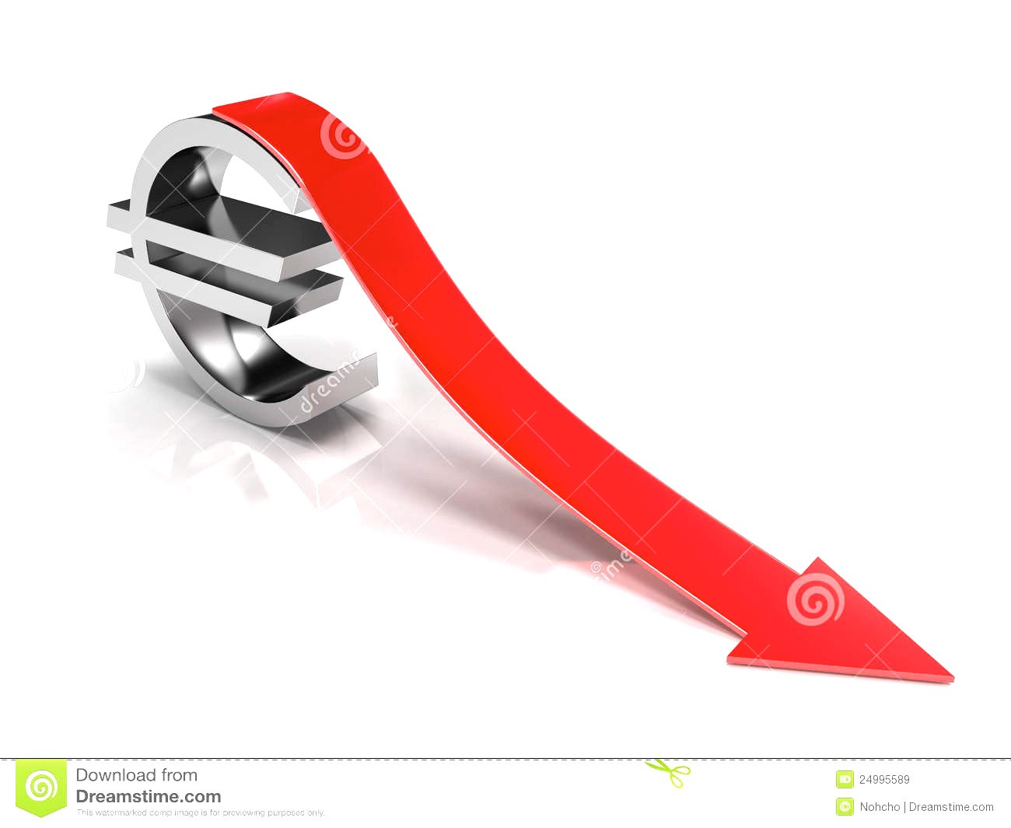
What is Deflation?

Slide 4
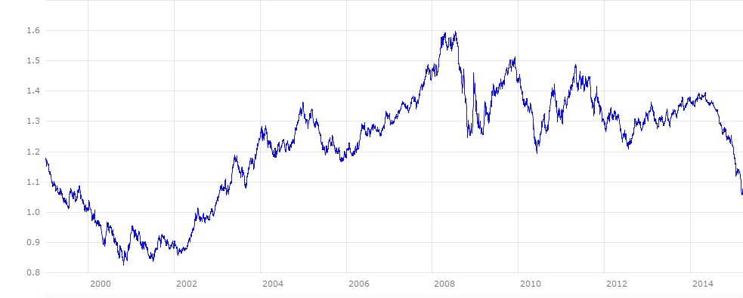
History of euro
2015
Boost invest.
Structural reforms
Growth-friendly fisc.policies
2013.Apr
Medium-long term plans and annual economic plans
2007
Credit boom
2005
Growth Path
1999.Jan
Launch of Euro
Adopted by 11 EU members over 15.
Traded at $1.1747
2002.Jan
Legal tender
Euro notes and coins became legal tender in 12 EU member states
2008.Sept
Lehman Brothers filed for bankruptcy
2010.Feb bailout for Greece
€110bn EU/IMF bailout for Greece to stem spread to rest of eurozone.
Nov. Irish crisis
Ireland asked for €85bn bailout as Portugal and Spain came under scrutiny
2014
Monetary policy decision
2012.Feb
Greece sealed a 2nd bailout worth 130bln euro
2001.Sept
Terrorist attack on the US.
The Euro fall below $0.90 again

Slide 5
Factor that caused Deflation
Oil-price slump

Slide 6
Consequences of Deflation
Deflation & Disinflation
Deflation represents a decrease in the prices of goods and services throughout the economy.
Disinflation represents a situation where inflation increases at a slower rate
Changes in Customer Spending
Adjust the structure of marketing
Boost enterprises’ competitiveness
crude-oil price $110 $60

Slide 7
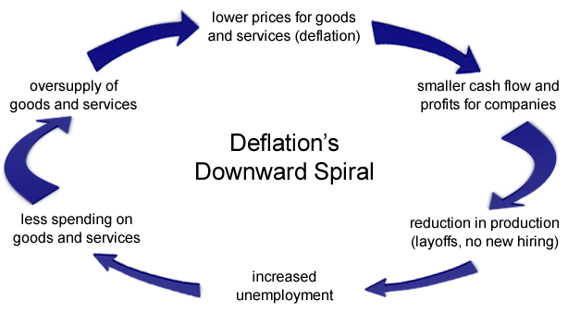
Consequences of Deflation

Slide 8
Policies
Monetary Policy
Unconventional Monetary Policies
Helicopter drop – print money
Quantitative easing
Change inflation expectations
Devaluation
Fiscal Policy

Slide 9
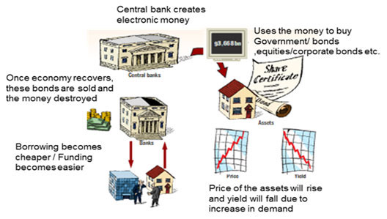
Policies
Quantitative easing (QE)

Slide 10
Policies
Monetary Policy
Unconventional Monetary Policies
Helicopter drop – print money
Quantitative easing
Change inflation expectations
Devaluation
Fiscal Policy

Slide 11
Questions to retain
When did deflation of euro reach a peak?
What caused deflation?
What was the role of ECB?

Slide 12
Thank You for Your Attention

